Slide 1
INTRODUCTION HELLO EVERYONE ,MYSELF KUMAR ANKIT PRESENT HERE WITH MY TABLEAU PROJECT & PRESENTATION. TOPIC OF MY PROJECT & PRESENTATION IS : - IPL CASE STUDY FOR THE YEAR 2016-2019 BEING A STUDENT OF BOARD INFINITY IT WAS VERY EXCITING TO WORK ON EVERY PROJECT . THIS TIME , I GAINED A DEEP KNOWLEDGE WHILE WORKING ON TABLEAU AND MAKING A DASHBOARD & PPT. AS I HV INTREST IN SPORTS THOGHT TO EXPLORE MYSELF IN THIS TABLEAU PROJECT , WITH THIS TOPIC IPL CASE STUDY FOR THE SEASONS DURING 2016 -2019 USING : - TABLEAU

Slide 2
CONTENT 1. INTRODUCTION 2. PROBLEM STATEMENT 3. CHART 1 WITH DESCRIPTION 4. CHART 2 WITH DESCRIPTION 5. CHART 3 WITH DESCRIPTION 6. CHART 4 WITH DESCRIPTION 7. CHART 5 WITH DESCRIPTION 8. CHART 6 WITH DESCRIPTION 9. CHART 7 WITH DESCRIPTION 10. CHART 8 WITH DESCRIPTION 11. CHART 9 WITH DESCRIPTION 12. CHART 10 WITH DESCRIPTION 13 CHART 11 WITH DESCRIPTION 14. CHART 12 WITH DESCRIPTION 15. DASHBOARD 16. CONCLUSION

Slide 3
PROBLEM STATEMENT MOST NO OF MATCHES PLAYED IN ALL SEASONS MOST NO. OF RUNS SCORED IN ALL SEASONS MOST NO. OF 50’s & 100’s maximum batting strike rate won maximum no of tosses faced most no of balls bowling innings for all teams in all seasons most no of wicket bowler who bowled most no. of overs maximum batting strike rate best average bowling economy rate total matches with total runs scored

Slide 4
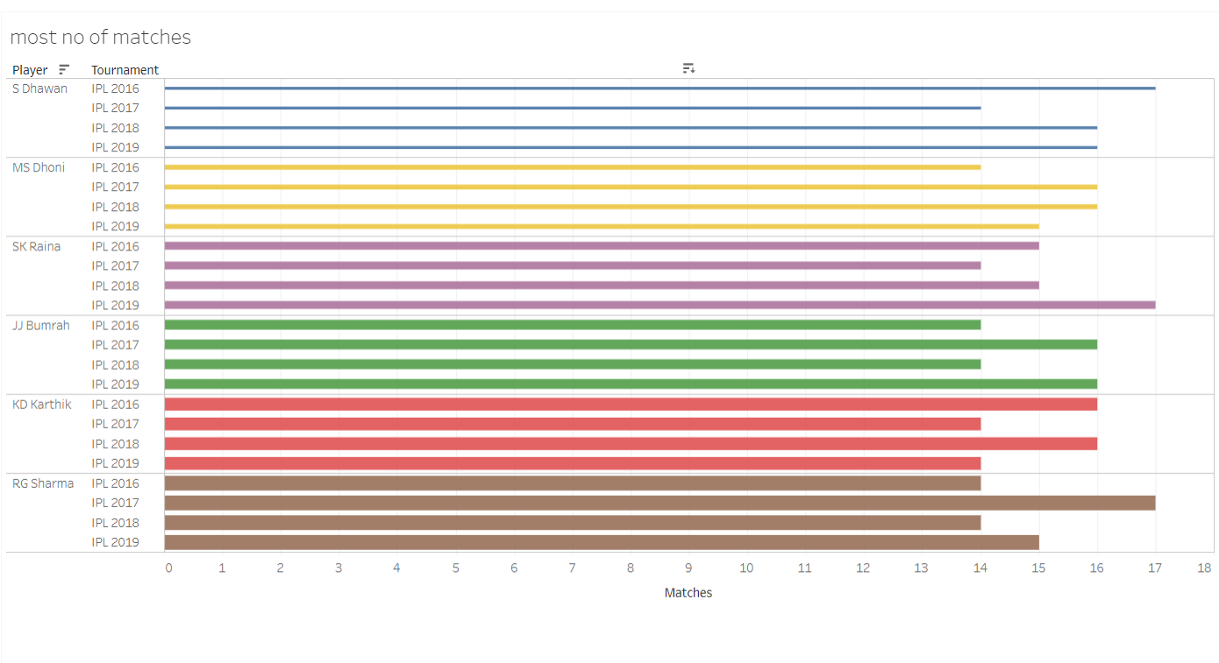
Here is my data chart – 1 which shows my top 6 players who have played most no. of matches . In all the seasons available for 2016-2019. as all the players have been assigned with different color as :- sikhar Dhawan with blue ms dhoni with yellow s. raina with deep blue j. bumrah with green kd . Kartik with purple & rohit Sharma with grey.

Slide 5
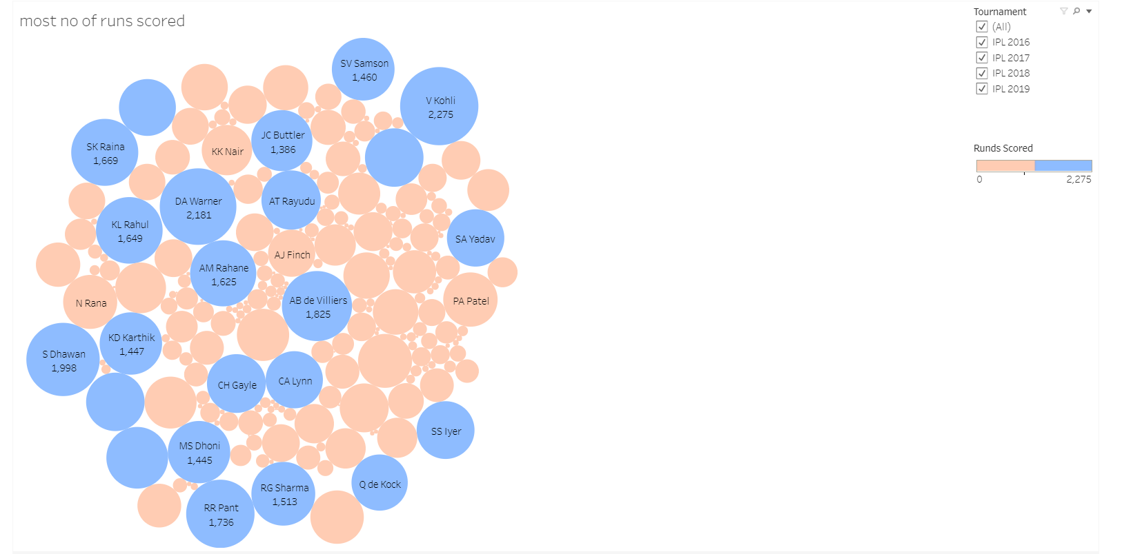
Data chart – 2 here, with my data chart 2 tells about the list of players who have scored most no. of runs in the seasons of 2016 – 2019. the players have been sorted accordingly and the size is based on the total runs scored similarly, runs scored above 1300 have been colored with blue rest the runs below 1300 with orange . And this data shows for the year 2016 - 2019

Slide 6
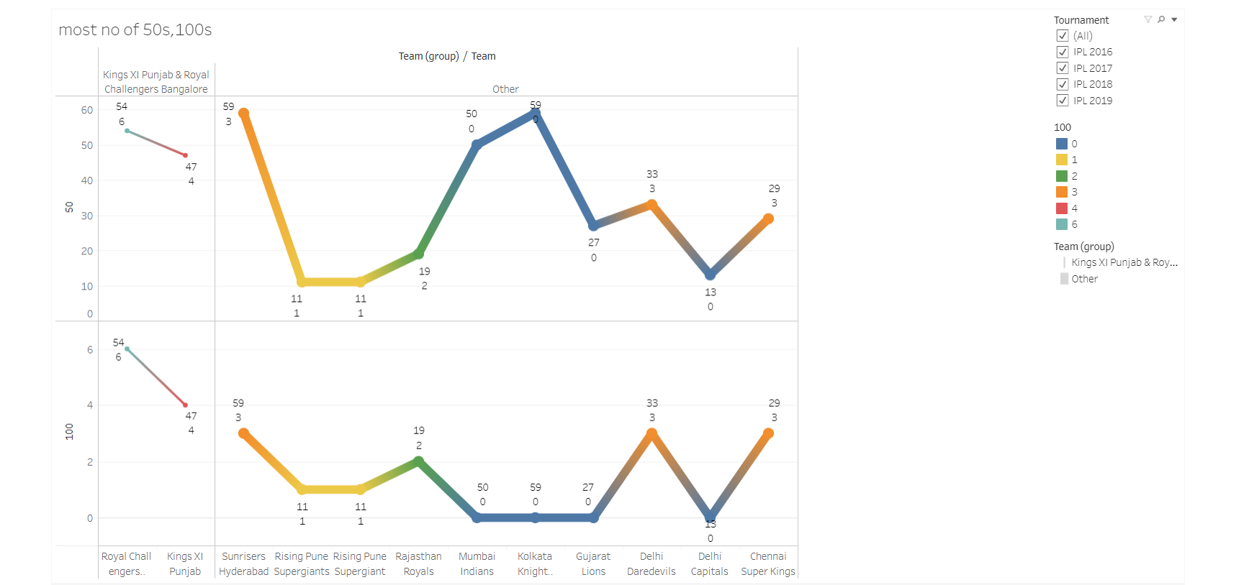
Data chart – 3 my data chart – 3 tells about the top 10 teams who have most no of 50’s & 100 in the year 2017-2019. here two teams have been grouped together and compared for rest others . Here every teams has some point shown with most no. of 50’s & 100 shown with the data labels .and sorted in highest to lowest with the different colors. Here kings 11 Punjab and royal challenger's Bangalore have been grouped together on the basis of highest no of 50’s & 100.

Slide 7
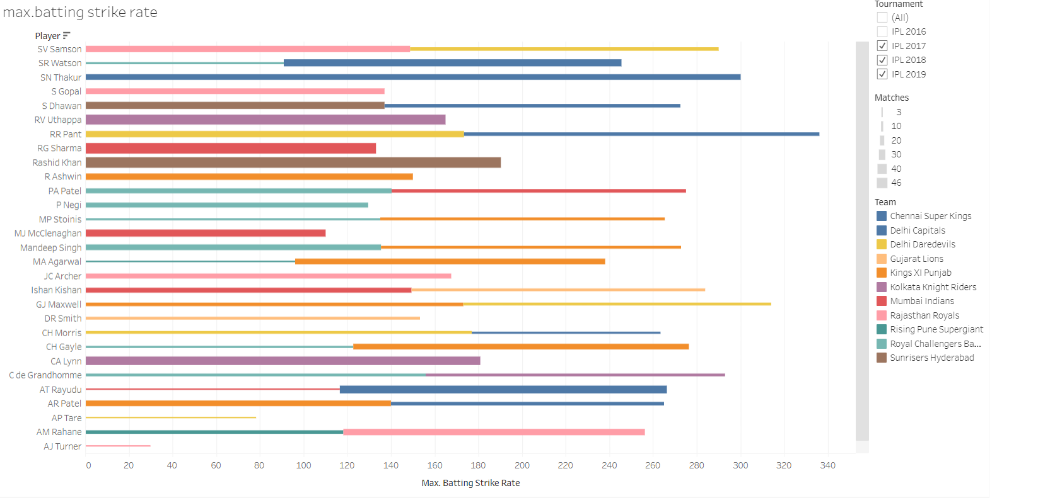
Data set -4 fourth data is about the top 10 players who have maximum batting strike rate . In the season 2017-2019. in this data it is explained with the data labels ND the colors have been assigned on the basis of teams . Total match played and total runs scored is also mentioned on it. For the respective season

Slide 8
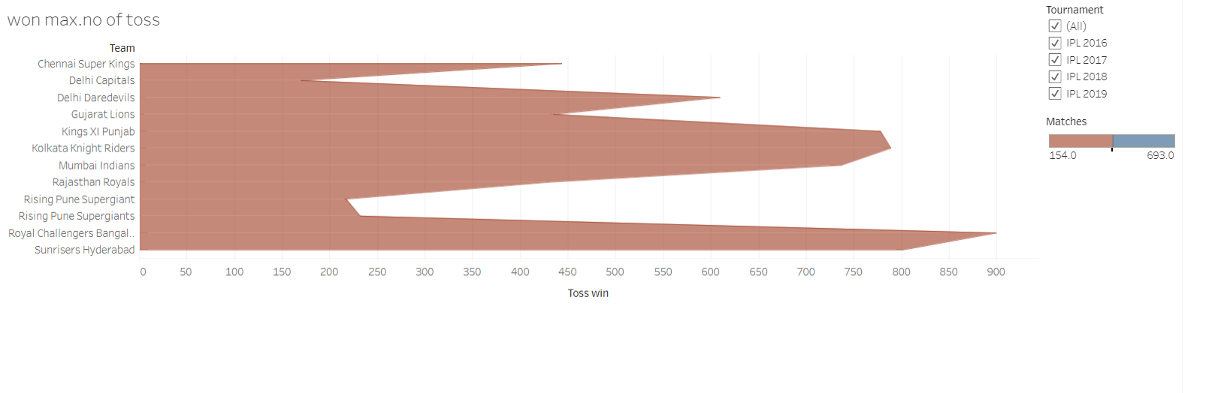
Data chart 5 my fifth data tells us about the list of all teams who have won most no of tosses . In all seasons . From 2016- 2019 for all the teams ..

Slide 9
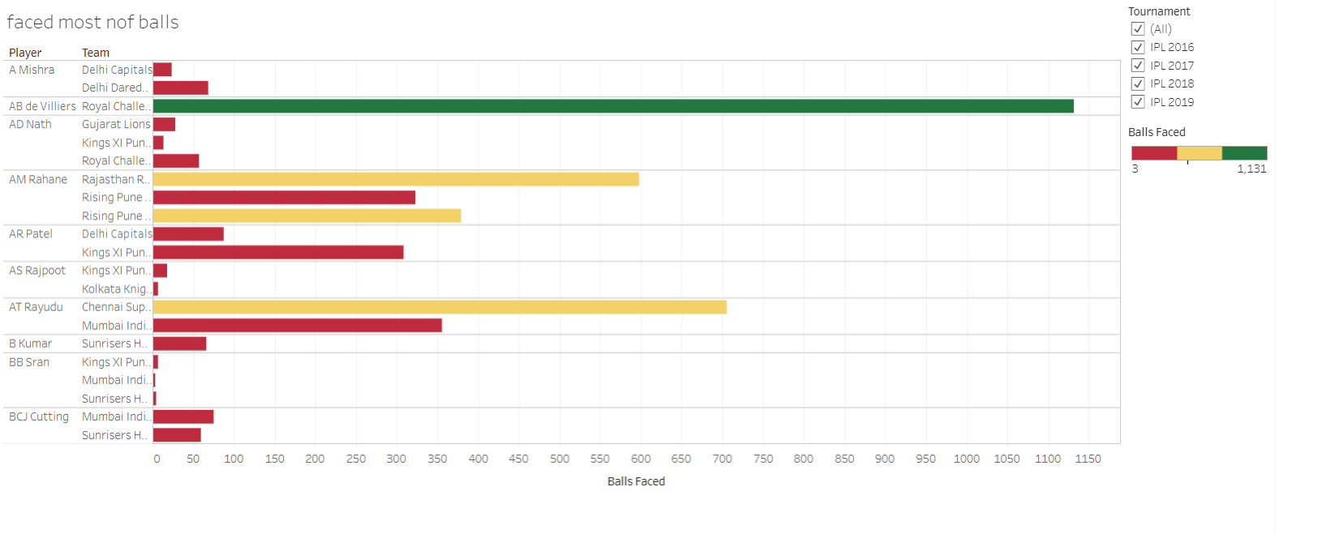
Data chart – 6 here, my 6th data chart tell us about the list of player who have faced most no of balls in all seasons . With the help of the data labels name of the payers , their teams & no. of balls faced is shown there. In dashboard for all seasons

Slide 10
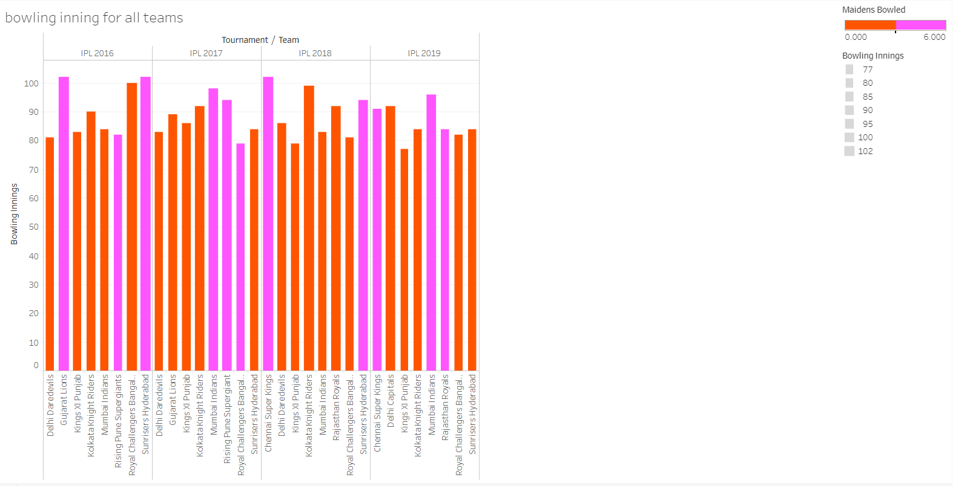
Data chart – 7 in my data chart 7 it explains about the bowling innings for all teams in all seasons . With their maiden overs bowled by the bowler. Coloring has been done on the basis of 1-3 overs maiden with orange color & more than 4-6 in pink

Slide 11
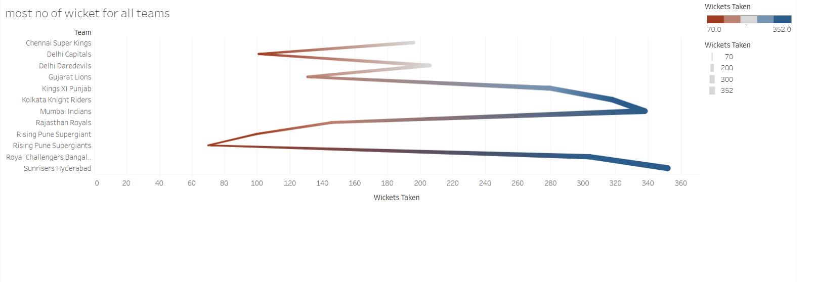
Data chart -8 my data chart 8 shows list of all the teams who have most no of wicket in the total match here all the teams have been shown in the chart and with the help of data labels the total wicket has been mentioned in the chart .

Slide 12
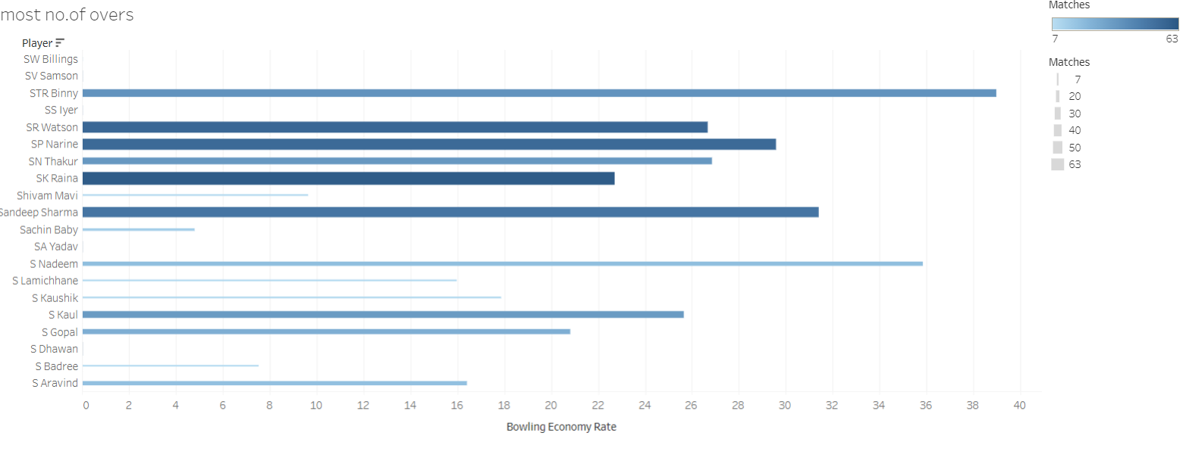
Data chart – 9 data chart 9 shows the list of all players who have bowled most no of overs in all season. Here name of the player , their team ,no. of overs bowled is shown with the data labels

Slide 13
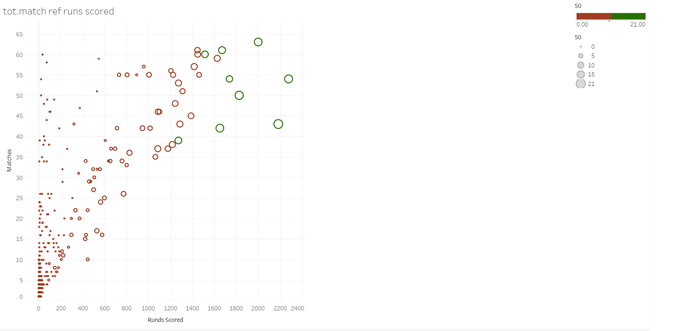
Data chart 10 in my last data chart it tells about the total matches with the total runs scored here , list of player has been added in the details to get the player who scored most no of runs with their total match has been added to label to get the value in how many matches the total runs has been scored , with their no of 50’s. The value in green denotes the highest no of 50 . i.e. more than 13 rest in purple denotes the no of 50 in the range of 2-10. bigger the size larger the no of 50’s.

Slide 14
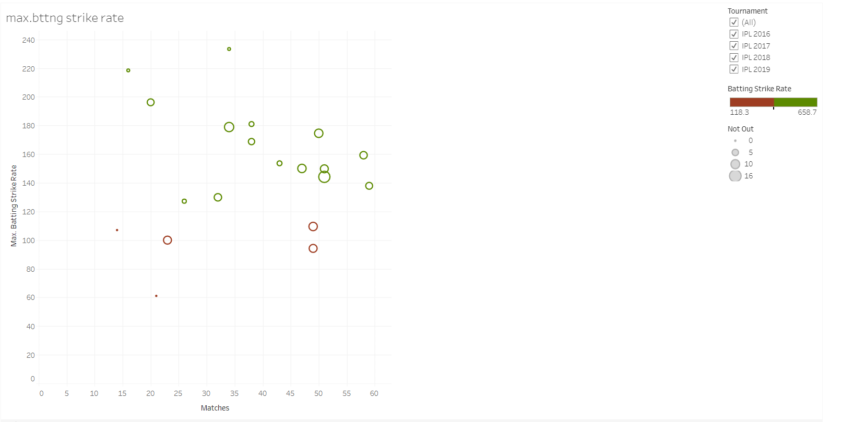
DATA CHART – 11 CHART 11 SHOWS THE MAXIMUM BATTING STRIKE RATE IN A SET OF MATCHES IN ALL SEASONS … HERE SIMILALRY, THE PLAYERS HAVE BEEN CATEGORISED ON THE CONDITION OF THE PLAYER WHO REMAINED NOT OUT . ALSO SHOWN WITH THE TOTAL RUNS SCORED IN TOTAL MATCHESWITH THE HELP OF DATA LABEL. SIZE OF THE CIRCLE IN THE SCATTER PLOT DEPENDS ON THE MAX. COUNT OF NOT OUT … IT SHOWS FOR ALL SEASONS .

Slide 15
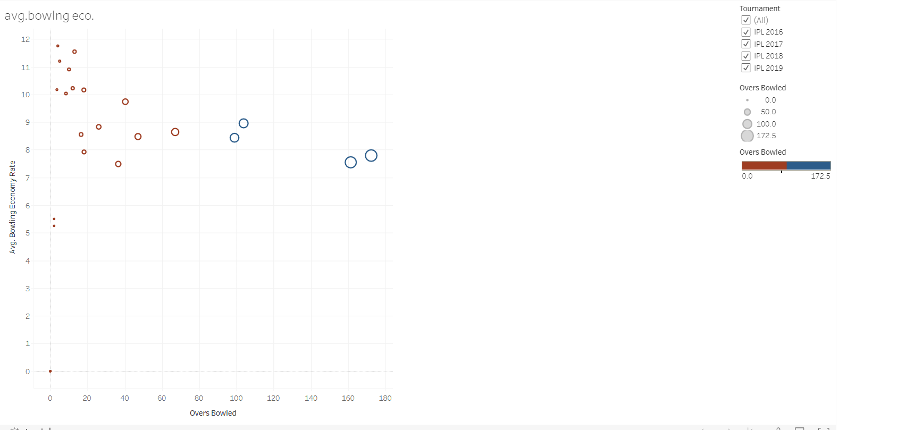
DATA CHART – 12 HERE MY DATA SHWOS THE AVERAGE BOWLING Economy RATE OF THE SET OF LISTED PLAYERS WITH THE NUMBER OF OVERS BOWLED. Basically the size is being done on the basis of most no of overs bowled nd colouring is also done on that basis for overs bowled more than 100 in blue nd rest with brown

Slide 16
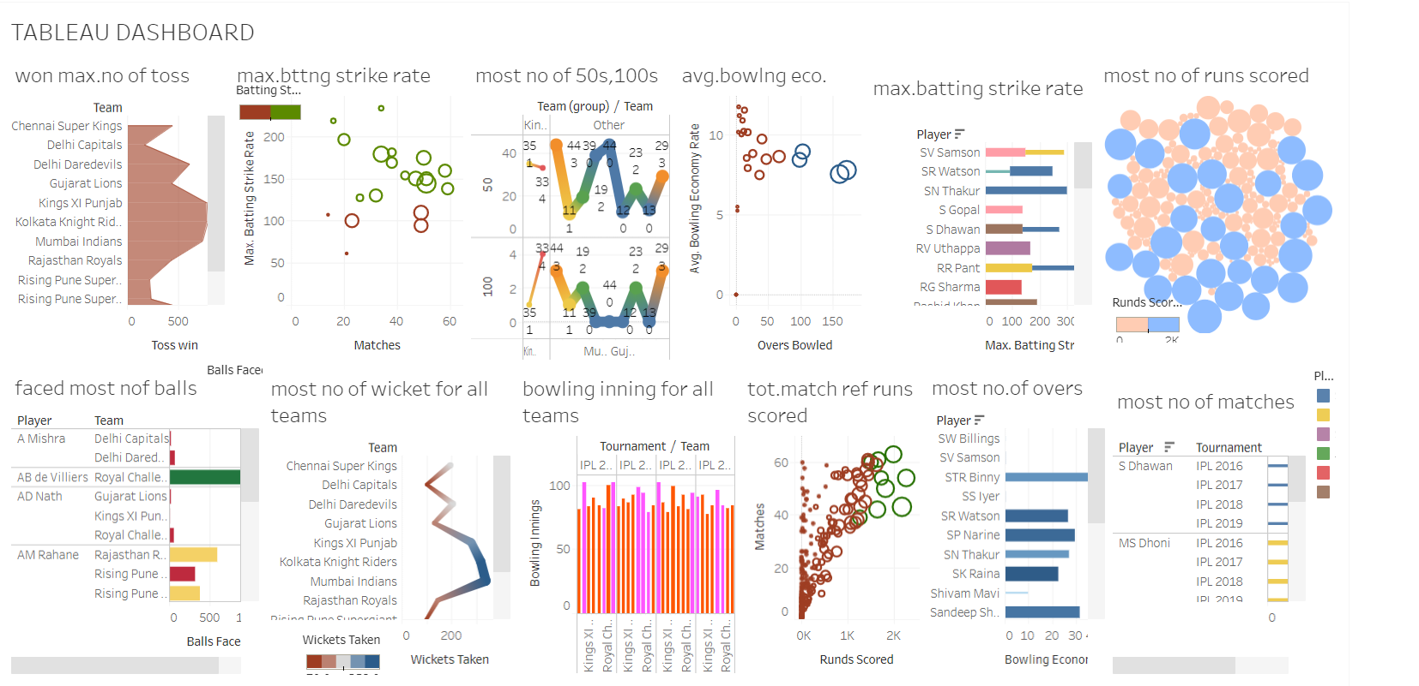
DASHBOARD THIS IS A SMALL VIEW OF A DASHBOARD .THAT HOW IT ACTUALLY LUKS LIKE . DASHBOARD HELPS TO GIVE A QUICK VIEW TO USER IN THE FORM OF GRAPHICAL VIEW TO GAIN SOME QUICK INSIGHTS FROM THE DATA AND HELP US TO ANALYSE THE KEY PERFORMANCE….

Slide 17
CONCLUSION LAST BUT NOT THE LIST, WHILE DOING THIS PROJECT AND PRESENTATION ,IT WAS QUITE INTRESTING TO GAIN SOME KNOWLEDGE ND APPLYING ON MAKING THE TABLUE DASHBOARD … GET TO LEARN ABOUT DIFFERENT PARAMETER TO SET ,HOW TO GROUP … IT WAS EXCITING TO LEARN ABOUT THIS WHILE MAKING PROJECT. AS IT HELPS TO FIND OUT SOME INSIGHT FROM THE DATA AND ANALYZE THE KEY PERFORMANCE ACCORDINGLY. REFERENCE https://www.kaggle.com/datasets

